Slide 1
Project Presentation of CO-OP Project at Industry (Module-2) (22CS421)
On
Student Attendance Management System
Navneet
Roll No: 2210991966
Supervised By
Simar Virk
Department of Computer Science and Engineering,
Chitkara University, Punjab

Slide 2
Introduction
Background
Traditional attendance tracking in educational institutions relies on manual paper registers.
This approach is time-consuming for instructors, prone to human errors, difficult to analyze over time, and risks data loss.
Objectives
Develop a Python system for attendance tracking
Enable daily marking with Present / Absent status
Generate detailed attendance reports
Calculate individual attendance percentages
Persist data across sessions via CSV files
2

Slide 3
Methodology
The project followed a structured four-phase development methodology:
Requirement Analysis - Identified functional needs through interaction with users
System Design - Modular design with separate functions for each feature
Development - Iterative Python coding with CSV-based data storage
Testing - Manual testing with sample data and edge case handling
3

Slide 4
Tools and Technologies
Python 3.10 - Core programming language with simple syntax and rich standard library.
csv Module - Built-in module for reading and writing CSV data files.
datetime Module - Auto-captures current date when attendance is marked.
os Module - Checks file existence for initialization on first run.
VS Code - Code editor used for development and debugging.
Git / GitHub - Version control and repository hosting for submission.
4

Slide 5
Implementation
Key Functions implemented in the system:
initialize_files() - Creates CSV files with headers on first run
add_student() - Registers student with roll no, name, branch
mark_attendance() - Records daily Present/Absent with auto-date
view_attendance_report() - Displays all records in tabular format
calculate_attendance_percentage() - Computes attendance % per student
5

Slide 6
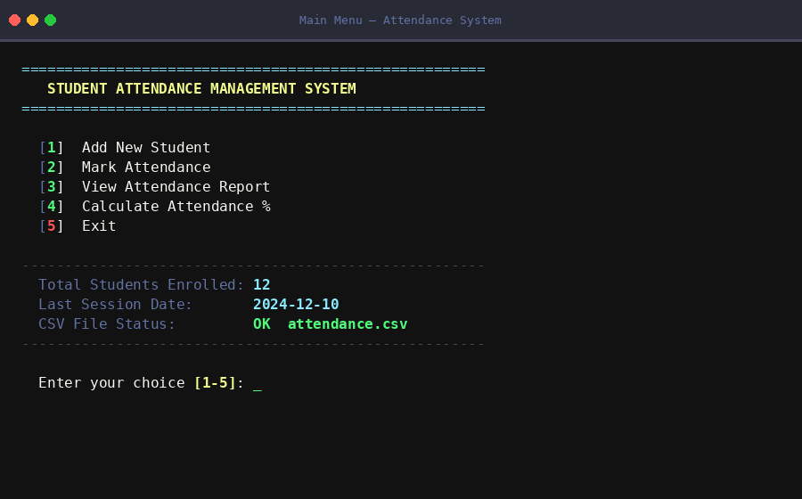
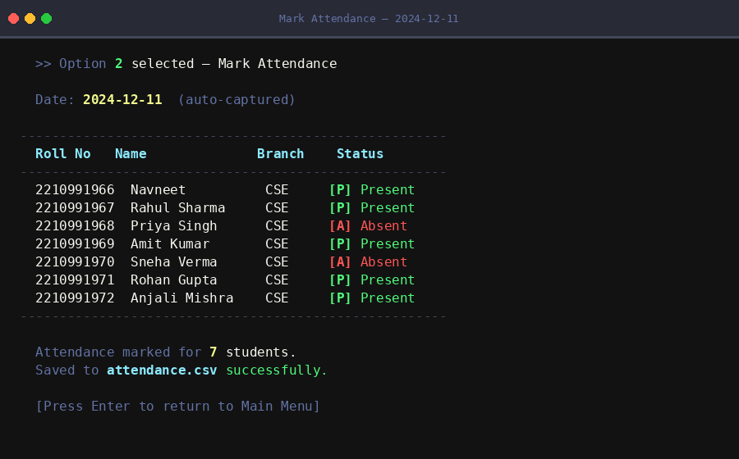
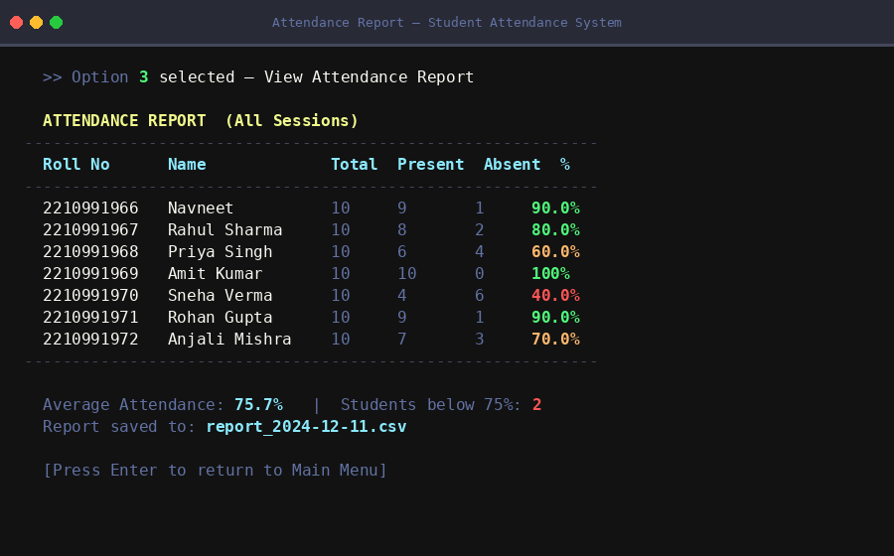
Project Screenshots
Fig 1: Main Menu
Fig 2: Mark Attendance
Fig 3: Attendance Report
System Overview:
Fig 1 shows the interactive main menu with 5 options: Add Student, Mark Attendance, View Report, Calculate %, and Exit.
Fig 2 demonstrates marking attendance for 7 students with auto-captured date and Present/Absent status saved to CSV.
Fig 3 displays the full attendance report with percentages — students below 75% are highlighted in red for easy identification.
5a

Slide 7
Results and Findings
Performance Metrics:
100% Functional Accuracy - All functions performed correctly during testing
Response Time under 1 second for all operations
Supports 100+ students in the attendance system
0 Data Loss Incidents during testing sessions
Key Observations:
All core functions worked correctly during testing with no data corruption
Attendance percentage matched manual calculations for all test cases
Invalid roll numbers were handled gracefully with clear error messages
CSV data persisted correctly across multiple application sessions
6

Slide 8
Conclusion and Future Scope
Conclusion:
System successfully digitizes attendance tracking
Cost-effective solution with no hardware needed
Practical application of Python and file handling
Industry best practices applied during CO-OP
Future Scope:
GUI using Tkinter or PyQt
Database integration with SQLite
User authentication system
Automated email alerts for low attendance
Web-based version using Flask
7

Slide 9
Thank You
Student Attendance Management System
Navneet | Roll No: 2210991966
navneet1966.be22@chitkara.edu.in
Department of Computer Science and Engineering, Chitkara University, Punjab

